Slide 1

GE DOCUMENTATION
2014 Leadership Meeting

Slide 2
Objectives:
To be able to locate and download GE documentation into your PC
Understand how GE documents are organized and how to look for information
Learn how to find the acronyms list
Become familiar with the parts manual
To gain a basic knowledge of the magnet documentation

Slide 3
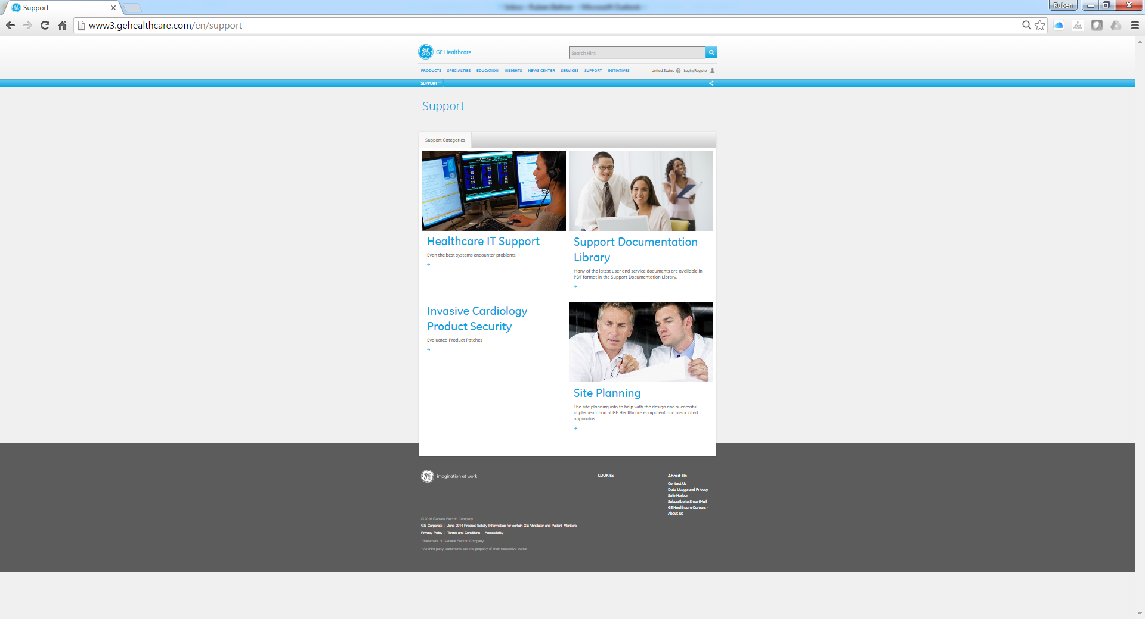
GE support website
http://www3.gehealthcare.com/en/support

Slide 4
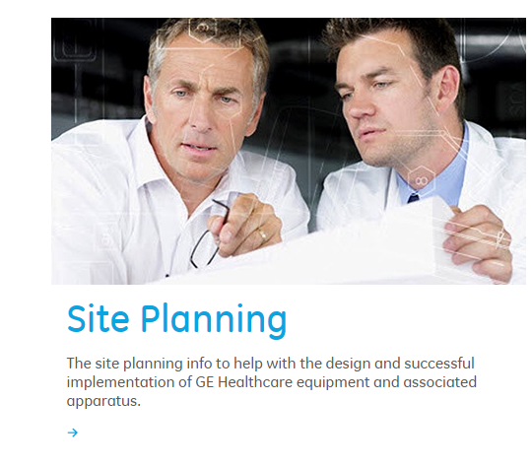
Pre-installation Manuals
Selecting the site planning we can find all the manuals for installation and facility requirements.

Slide 5
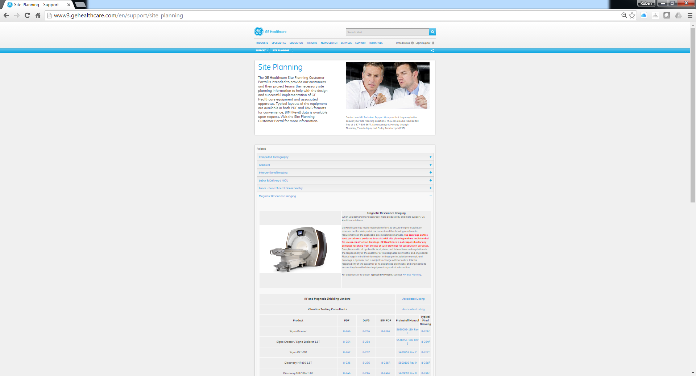
Pre-installation Manuals
Click in the Magnetic Resonance section to unfold the list of MR systems.
Click on the desired manual

Slide 6
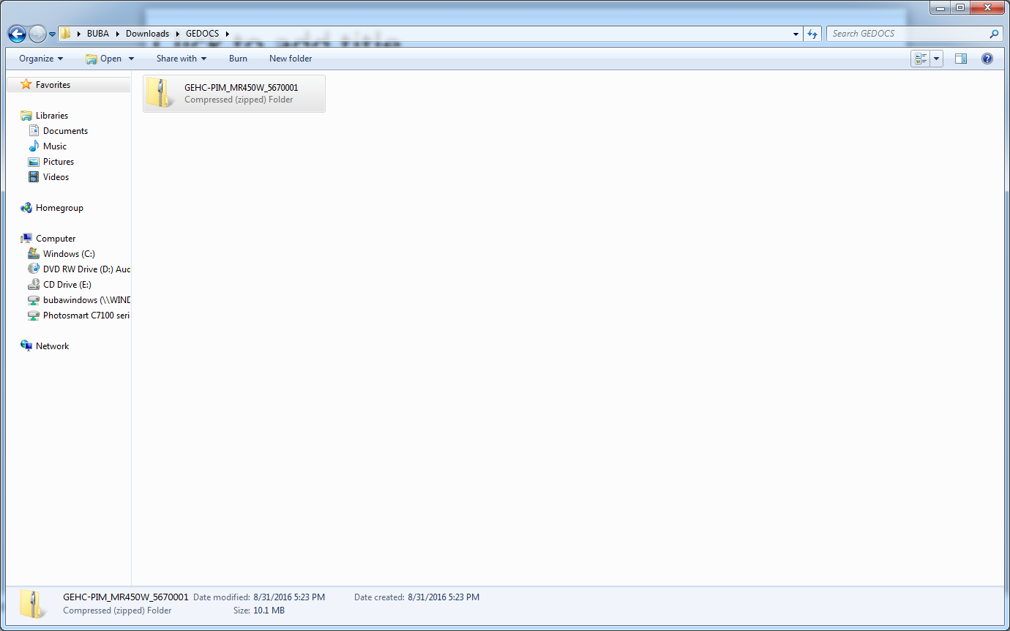
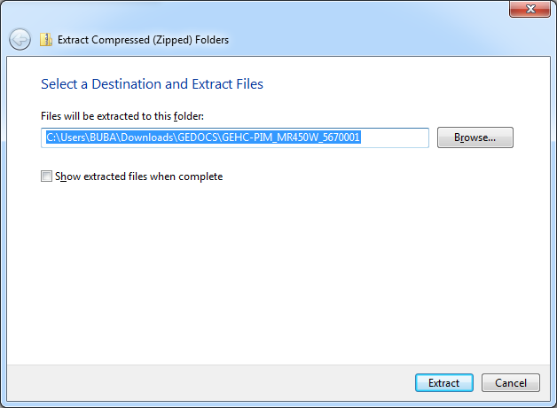
Pre-installation Manuals
Select a folder to save the download or it might download to a default folder depending on the browser you are using and configuration.
It will download a compressed folder in zip format.
Unzip it using windows at the same location or a different desired folder

Slide 7
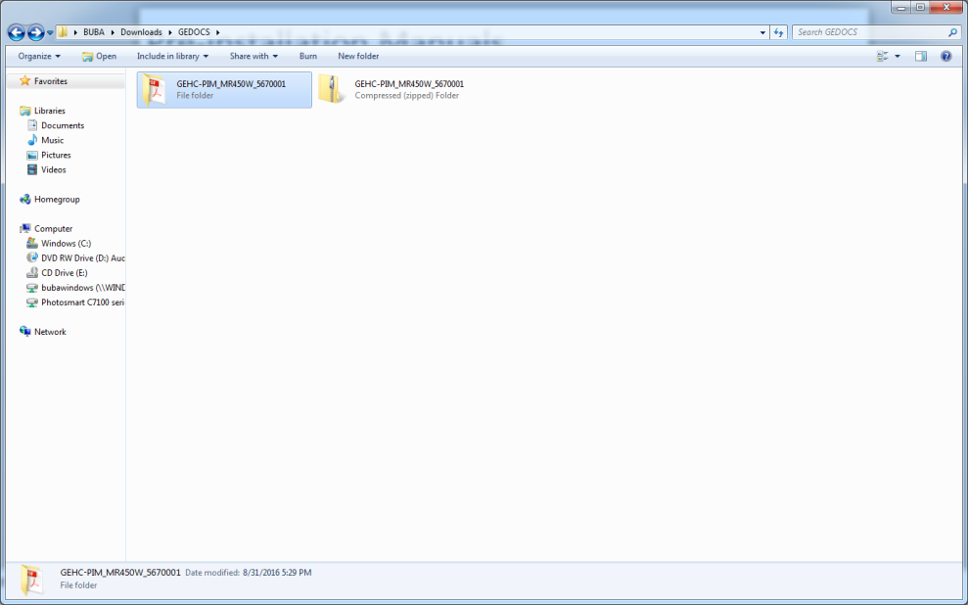
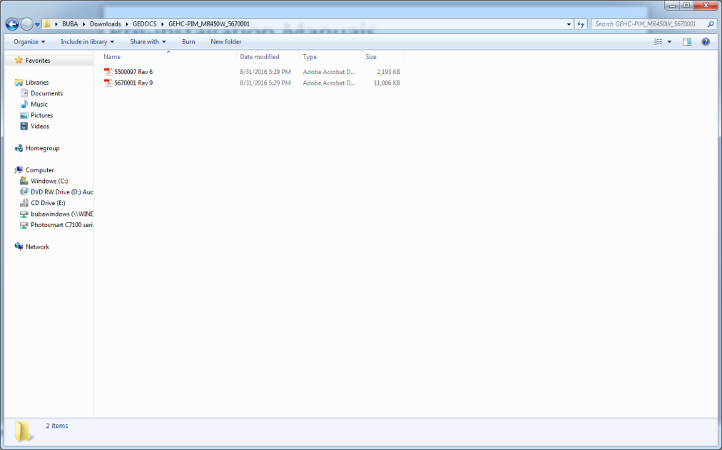
Pre-installation Manuals
It will create an unzipped folder with the contents downloaded inside
You can now open the files or rename and relocate as desired.

Slide 8
Pre-installation Manuals
All information regarding:
Site dimensions
Power requirements
Temperature and humidity requirements
Safety requirements
Fringe field
And others
can be found in this manual.
NOTE: Some of the pre-installation manuals can be found in the Service Methods CD-ROM but GE has been taking out the pdf files from there and referring you to download it separately.

Slide 9
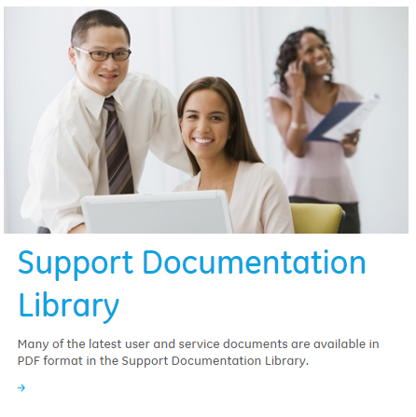
Service Documents
Selecting Support Documentation Library in the first Support link we are sent to the CDL or Common Documentation Library

Slide 10
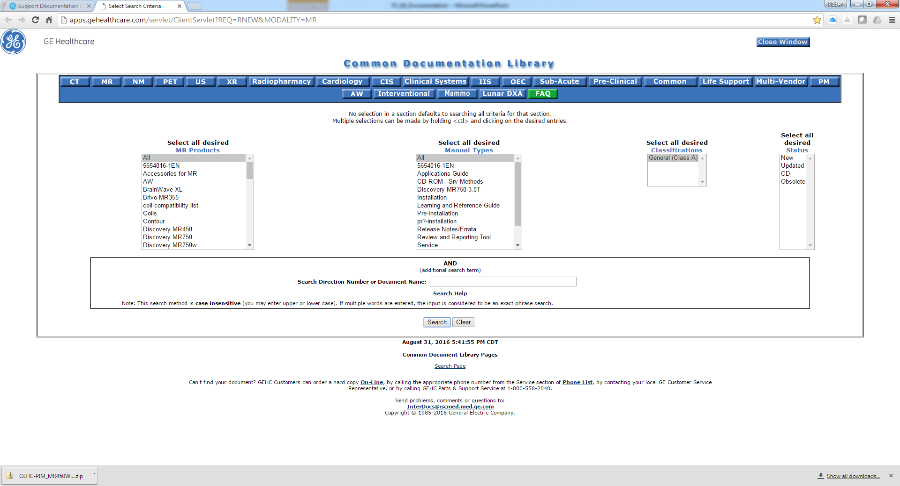
Service Documents
We can find the link to the library for all the modalities.
We select MR

Slide 11
Service Documents
We select the MR Product and usually leave All as default under the Manual Type box.
The search box at the bottom doesn’t usually give you what you are looking for.
Sometimes it takes a bit of playing with the selections to find what you are looking for

Slide 12
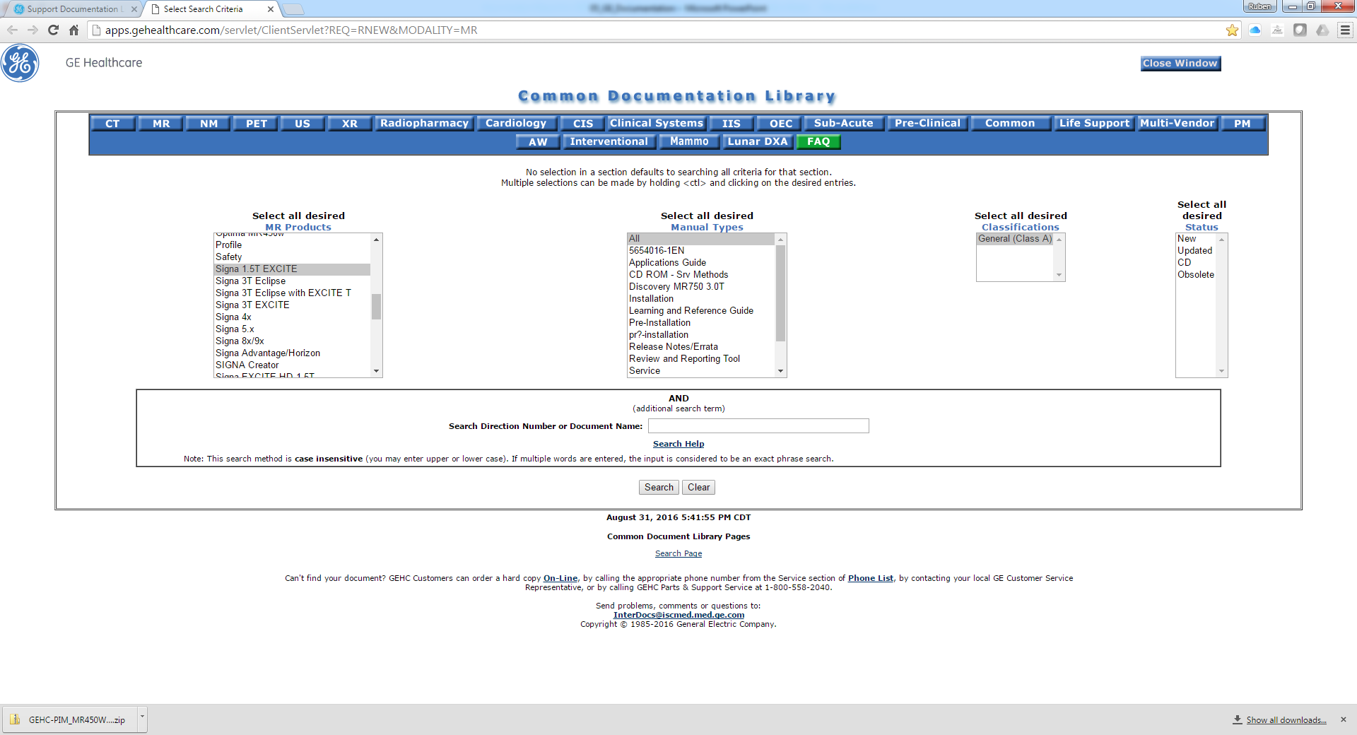
Service Documents

Slide 13
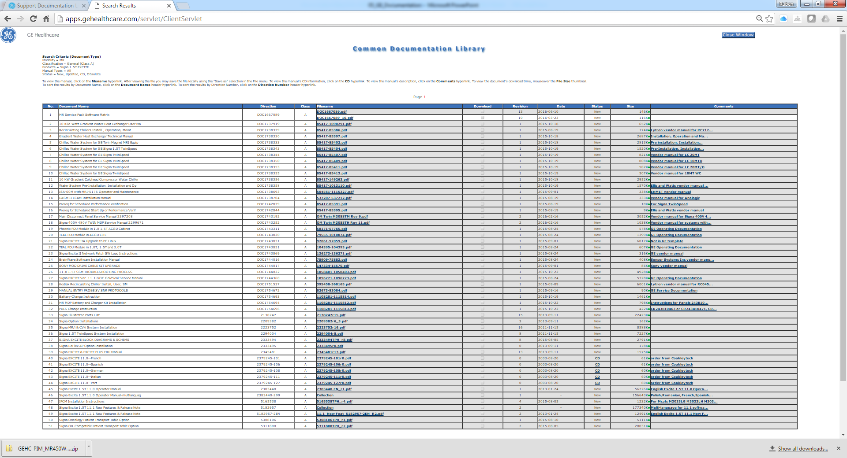
Service Documents
Most of the time we will be looking for the Service Methods CD and will show up as a .zip filename.
11x is a good example of one that you won’t find easily…

Slide 14
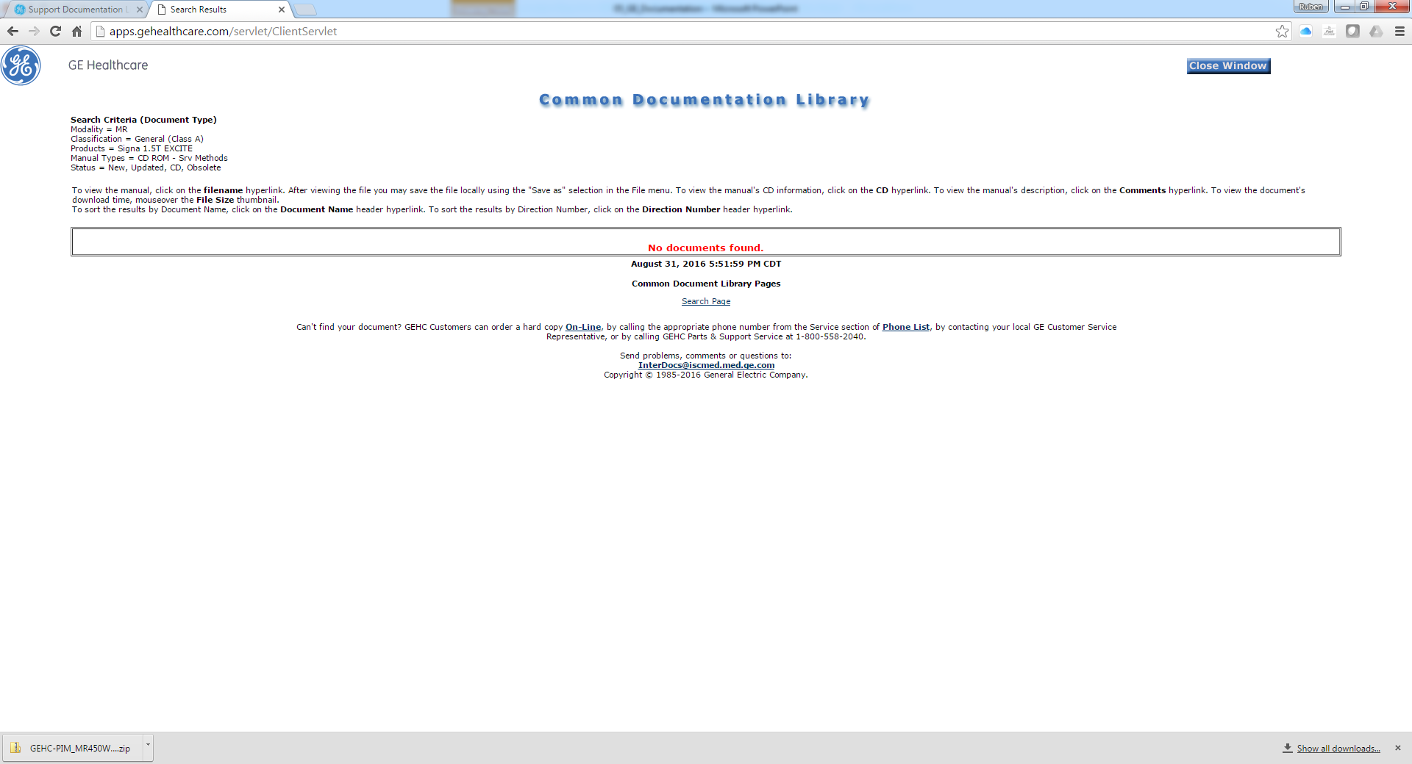
Service Documents
If we try to select ‘CD ROM - Srv Methods’ in the previous search screen we don’t have much luck either…

Slide 15
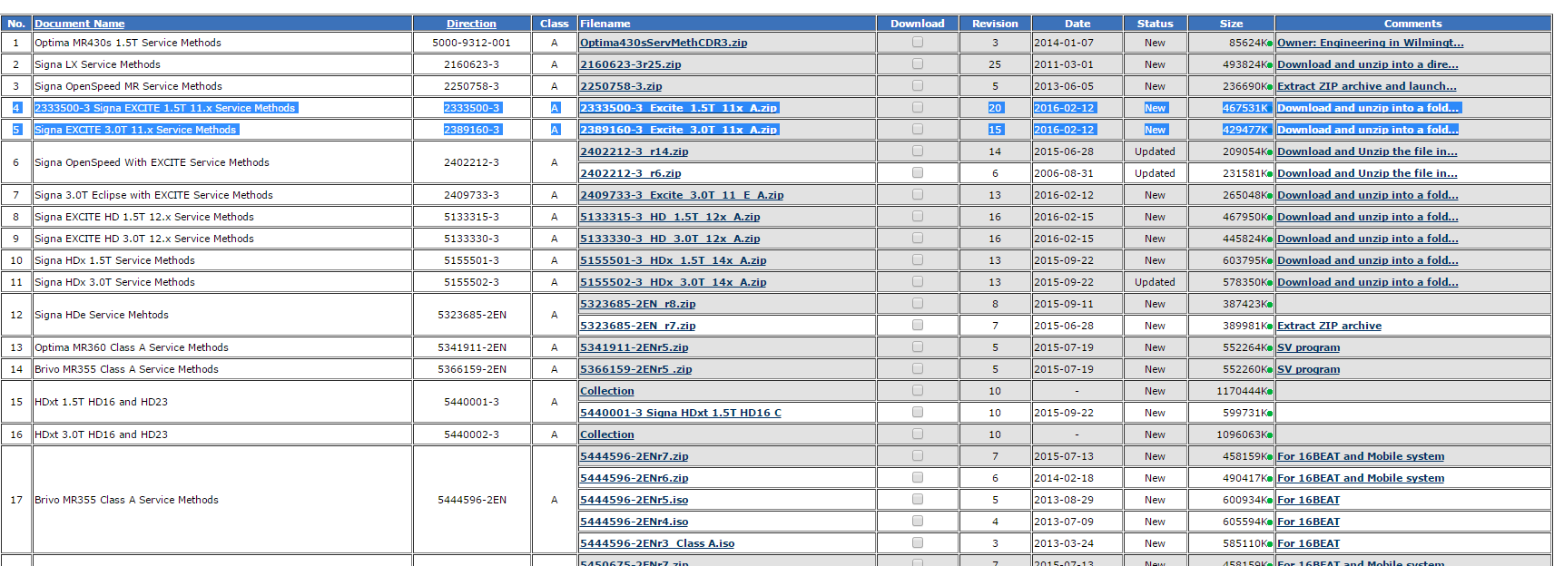
Service Documents
If we don’t select the MR product and select all Service Methods it shows up
Not all the Service Methods are found here though…
No, it is not perfect, but once you get used to it you can find almost anything.

Slide 16
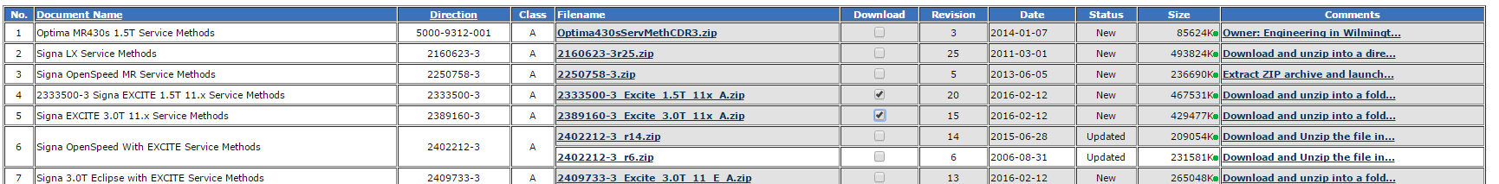
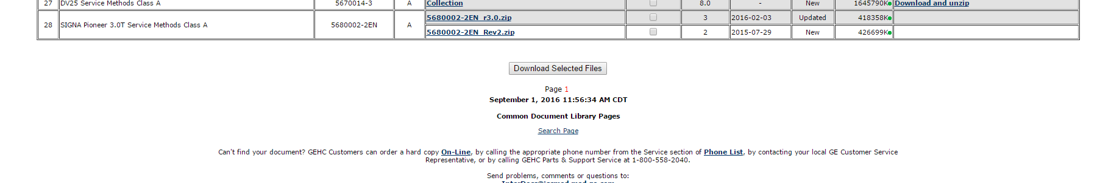
Service Documents
Select the CDs you want to download
Click on ‘Download Selected Files’

Slide 17
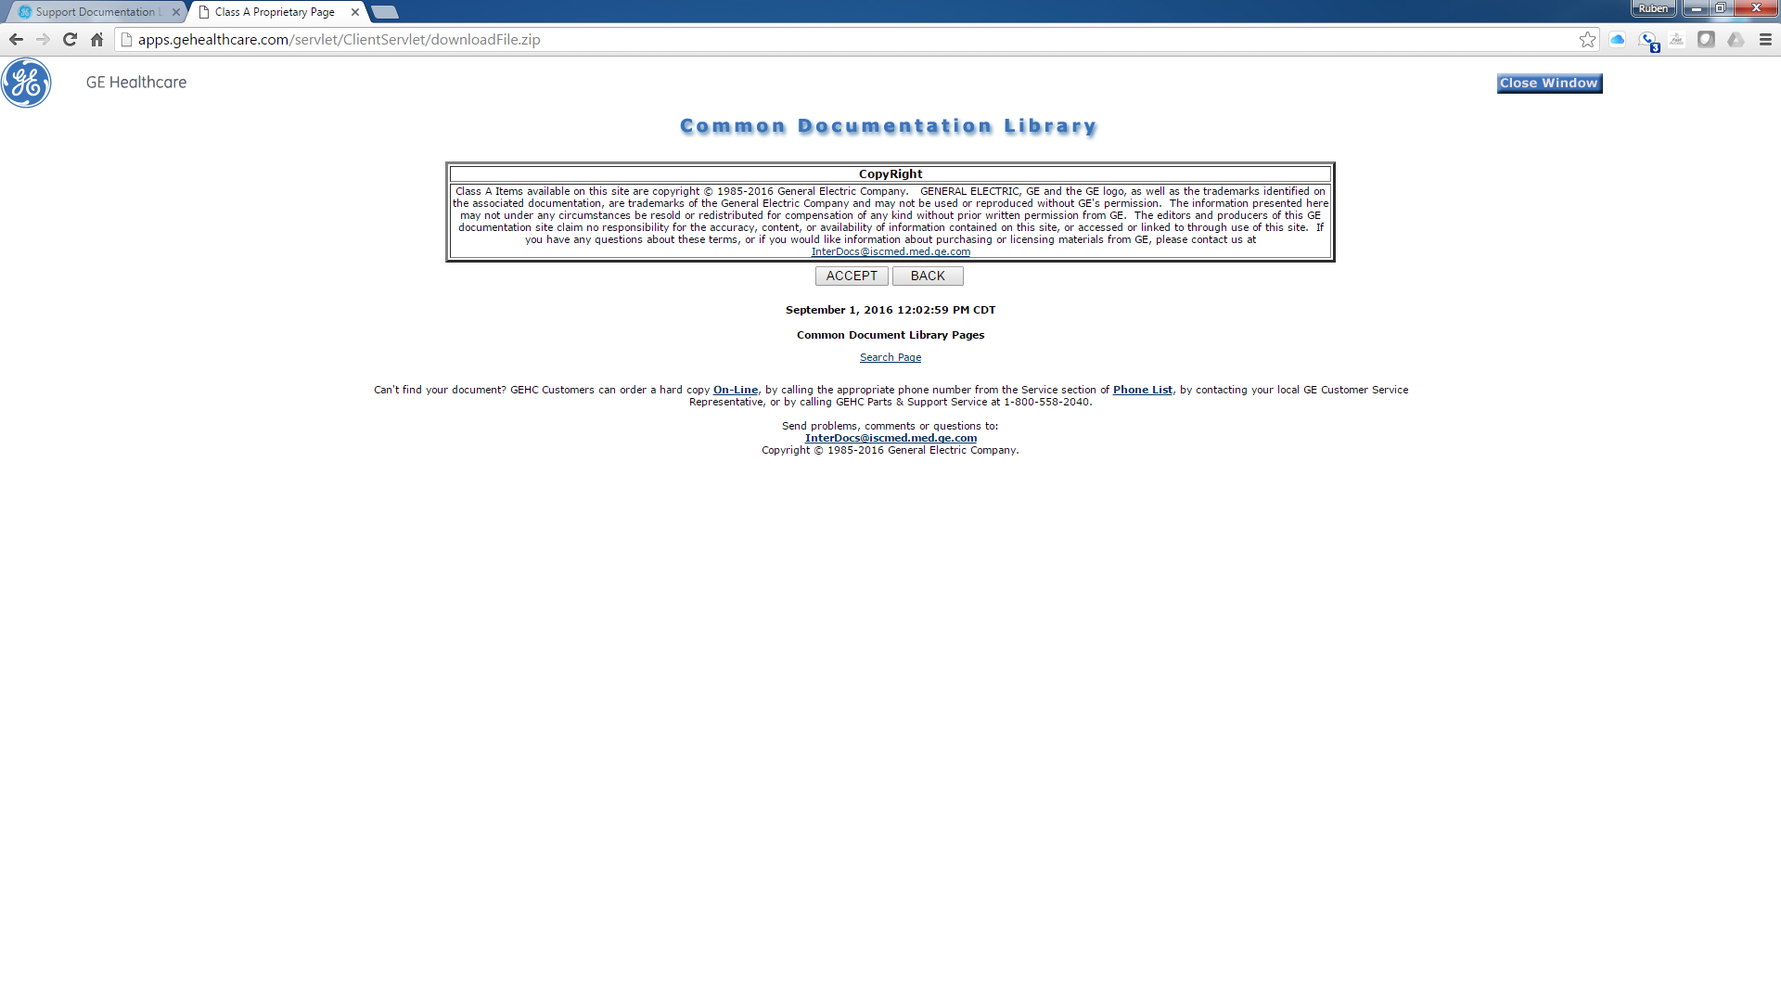
Service Documents
Click the ‘Accept’ button to begin the download
You will have to select the folder where you want to save the downloaded zip folder or it will download to your default selection.

Slide 18
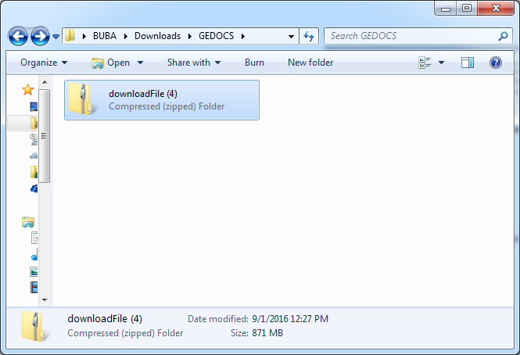
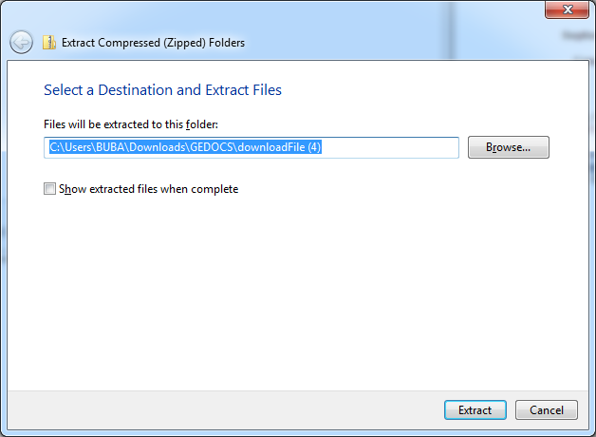
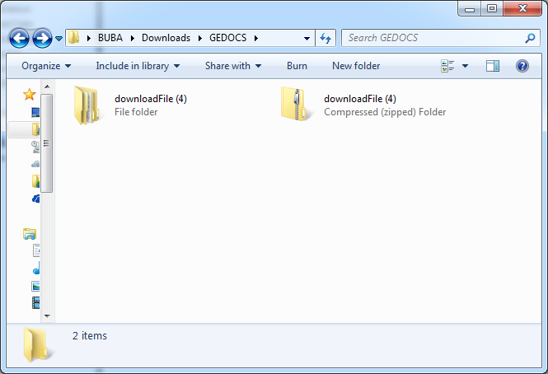
Service Documents
Unzip the folder created

Slide 19
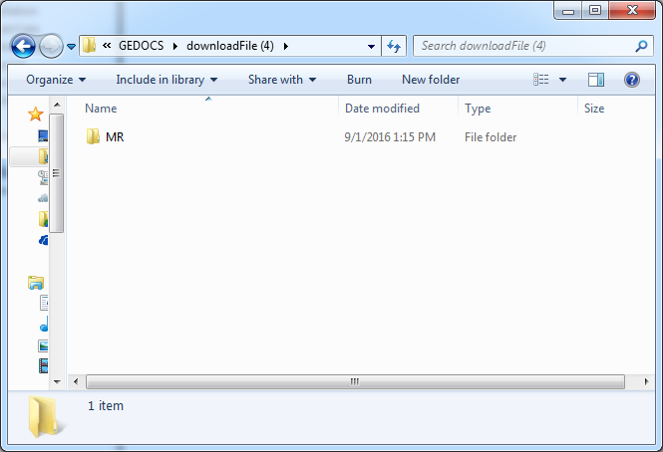
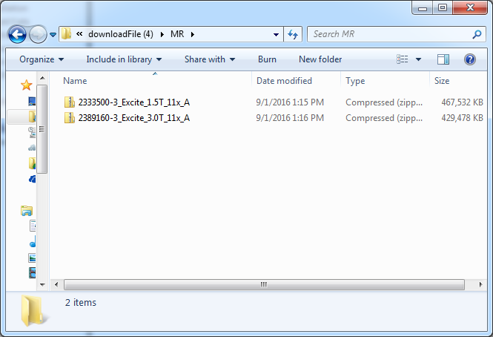
Service Documents
The unzipped folder has another folder named MR inside and that folder will contain the number of CDs or documents you decided to download in the CDL website.

Slide 20
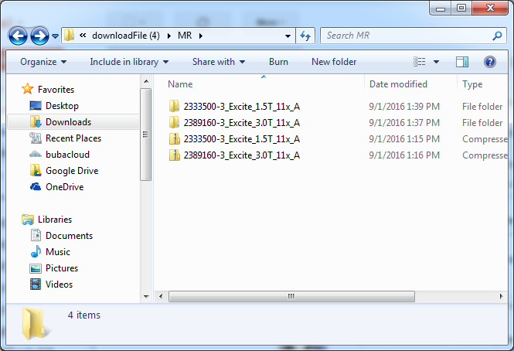
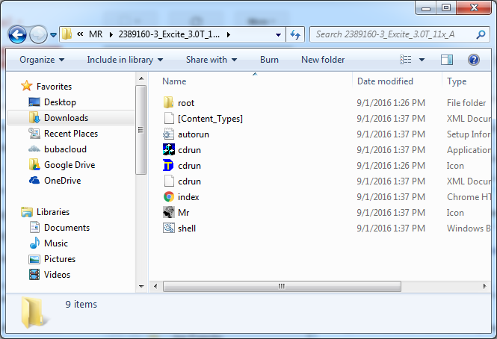
Service Documents
Extract the folders and keep going down the tree and extracting until there are no more compressed folders

Slide 21
Service Documents
The final result for a Service Methods CD-ROM should look like this always:

Slide 22
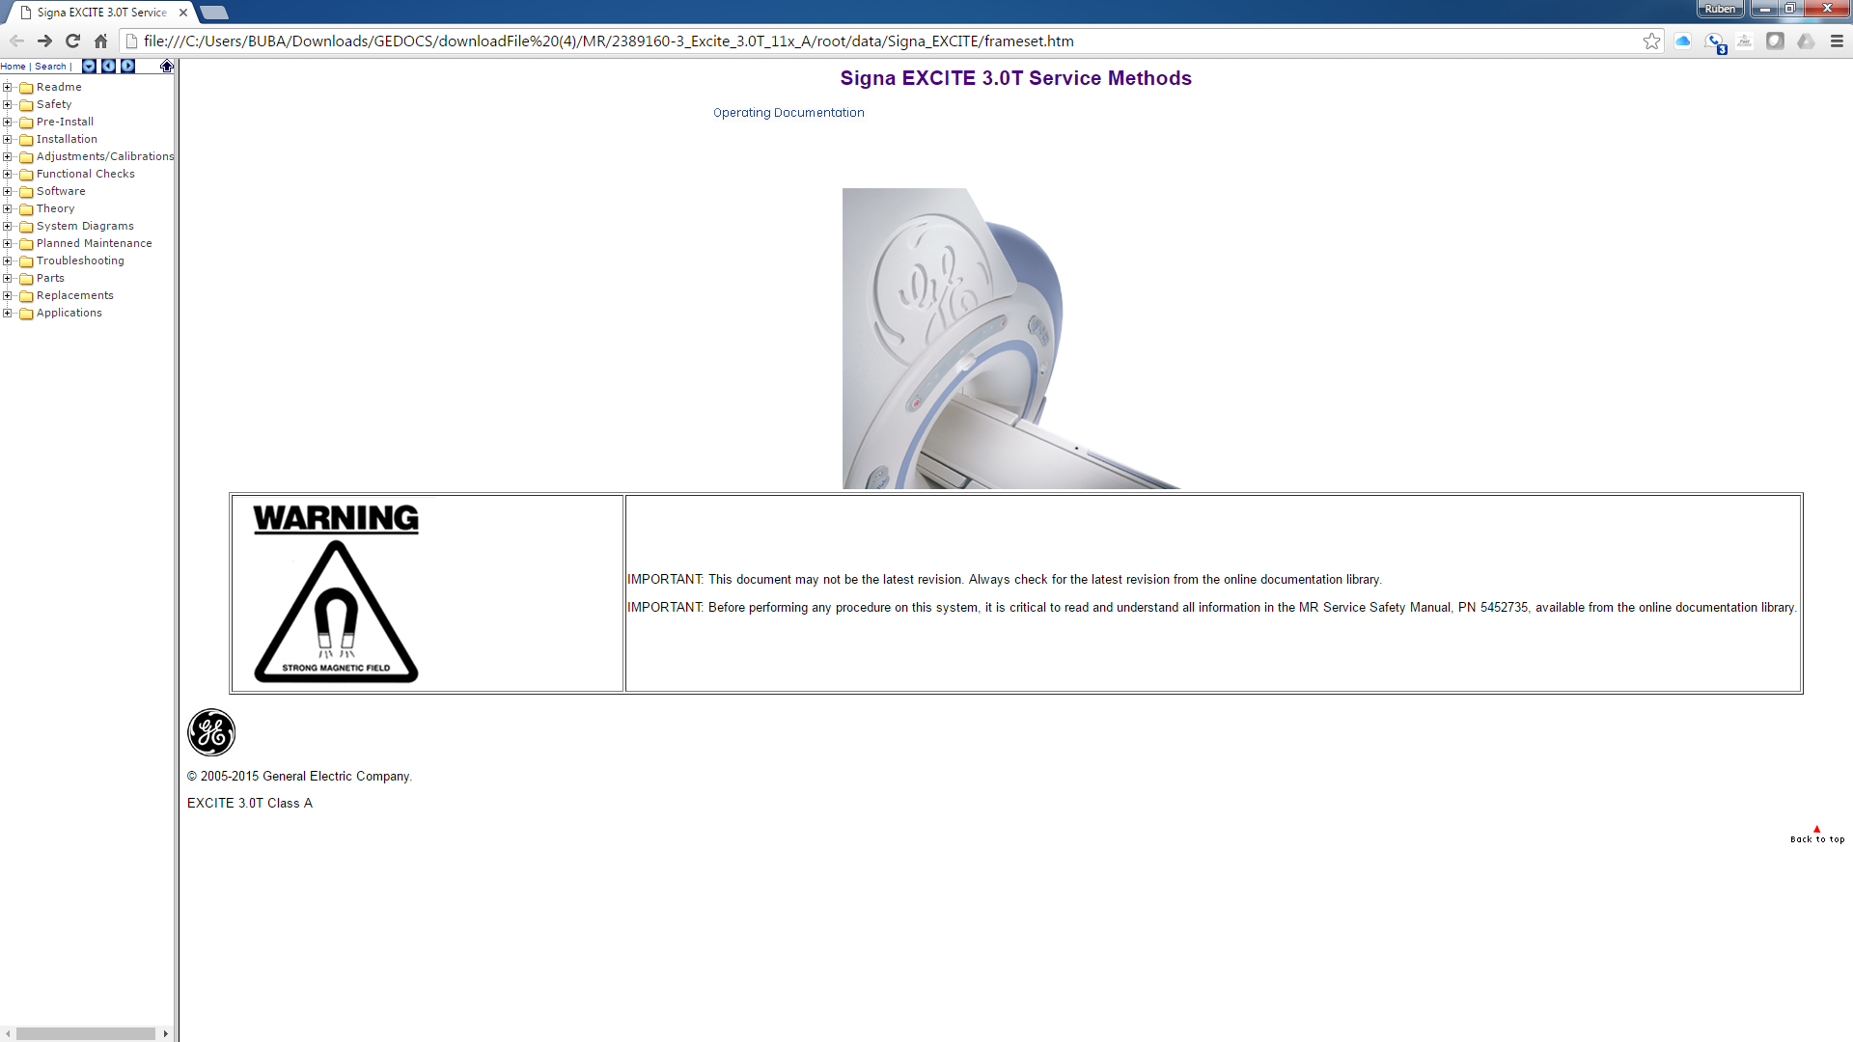
Service Documents
The index.html will open the main menu contents in the browser of your choice.

Slide 23
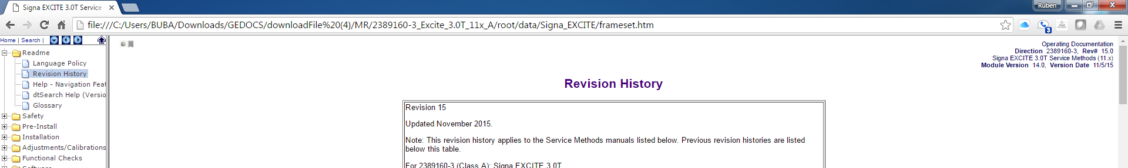
Service Documents
The Revision History under Readme gives you the date and revision you are looking at.

Slide 24
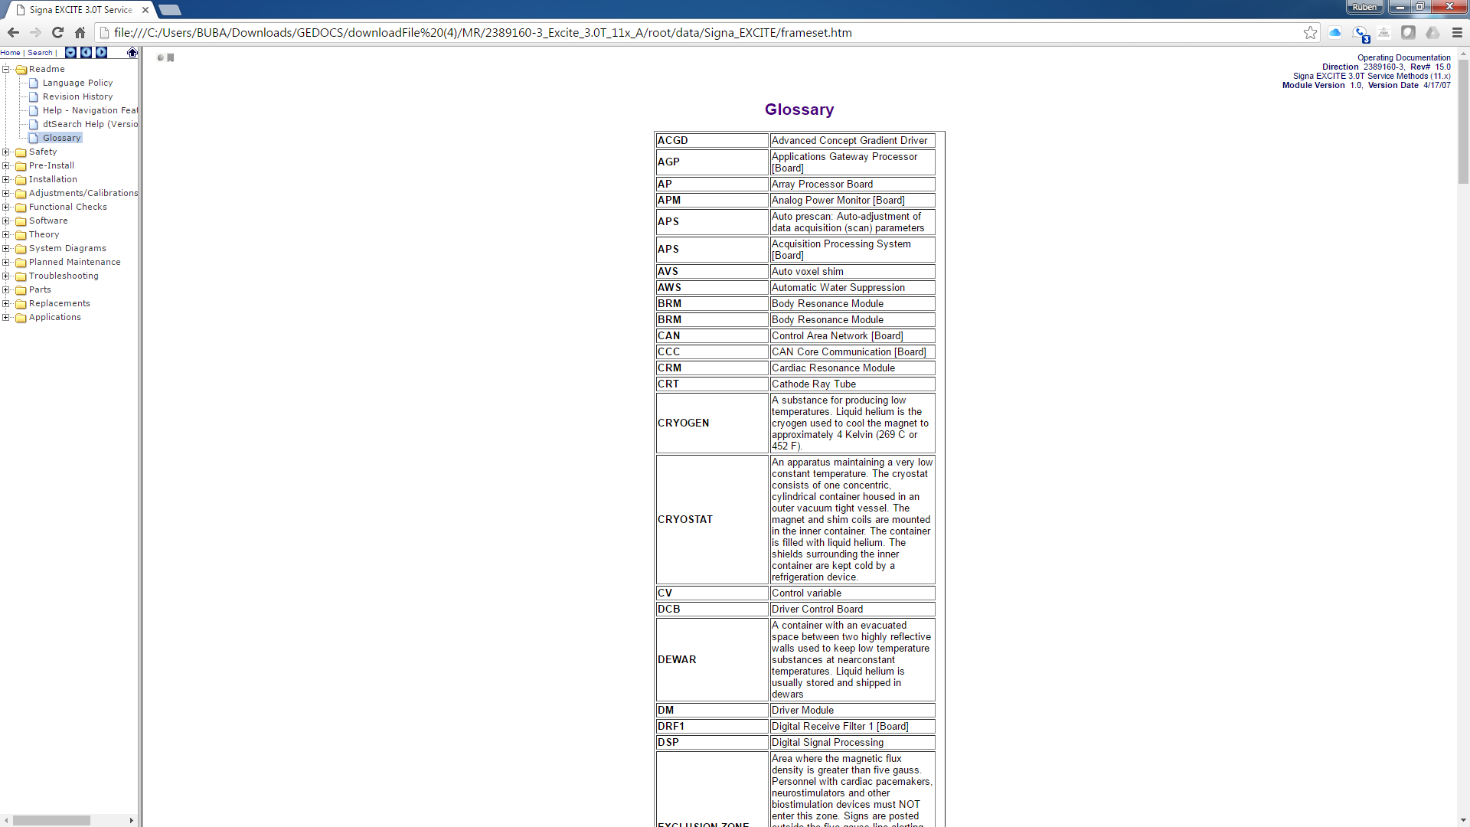
Service Documents
The Glossary will give you a list of acronyms in case you are curious to know what they stand for.

Slide 25
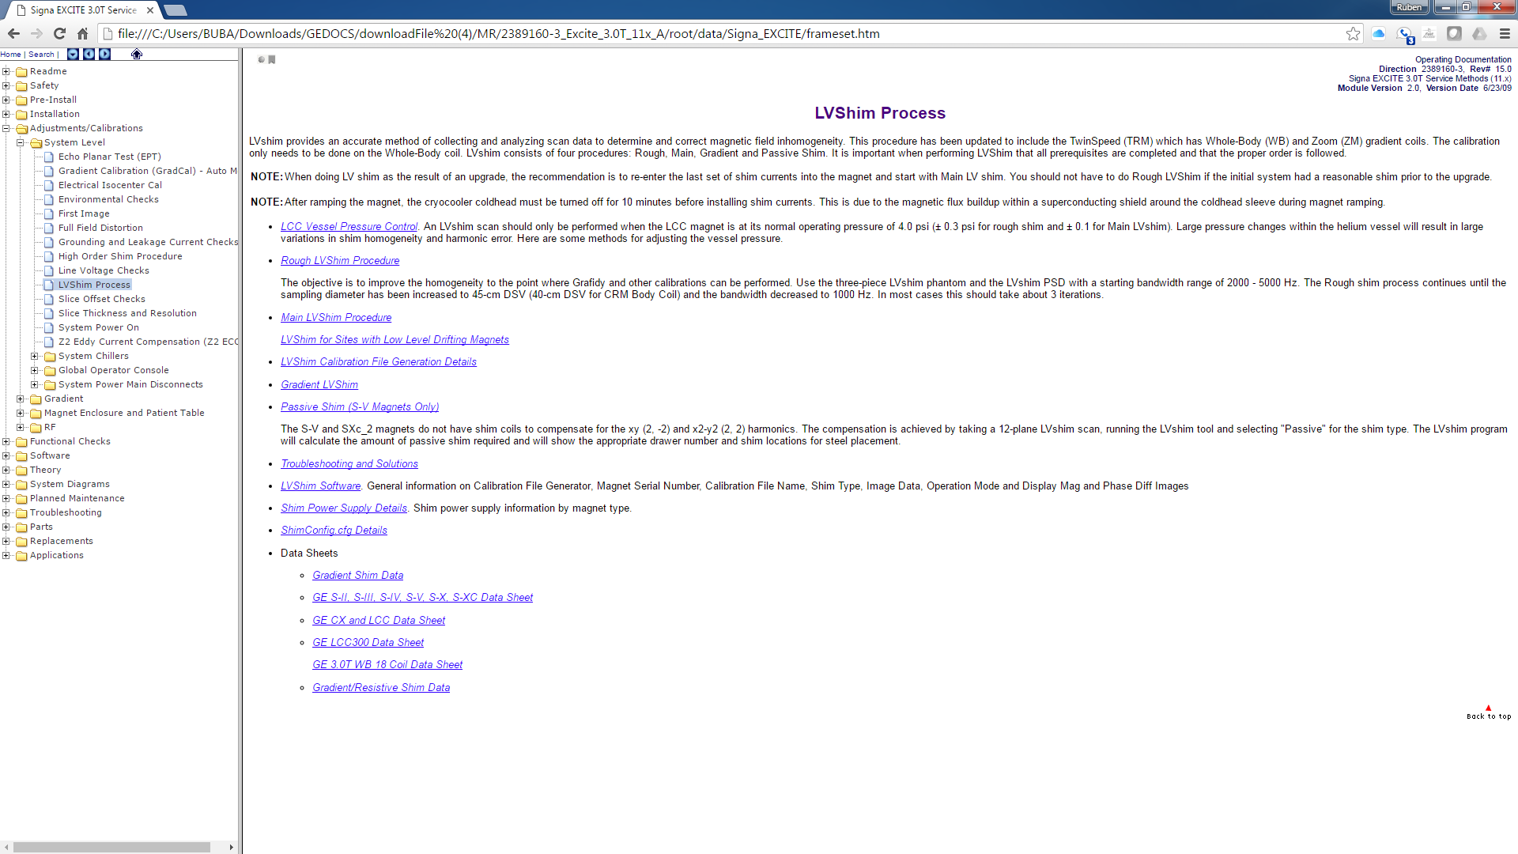
Service Documents
Under Adjustment/Calibrations we will find most of the instructions on how to run calibrations in a system. Keep in mind that some of them are taking right out from the proprietary CD and they do not work exactly the same. Many of the mechanical adjustments can be found here too.

Slide 26
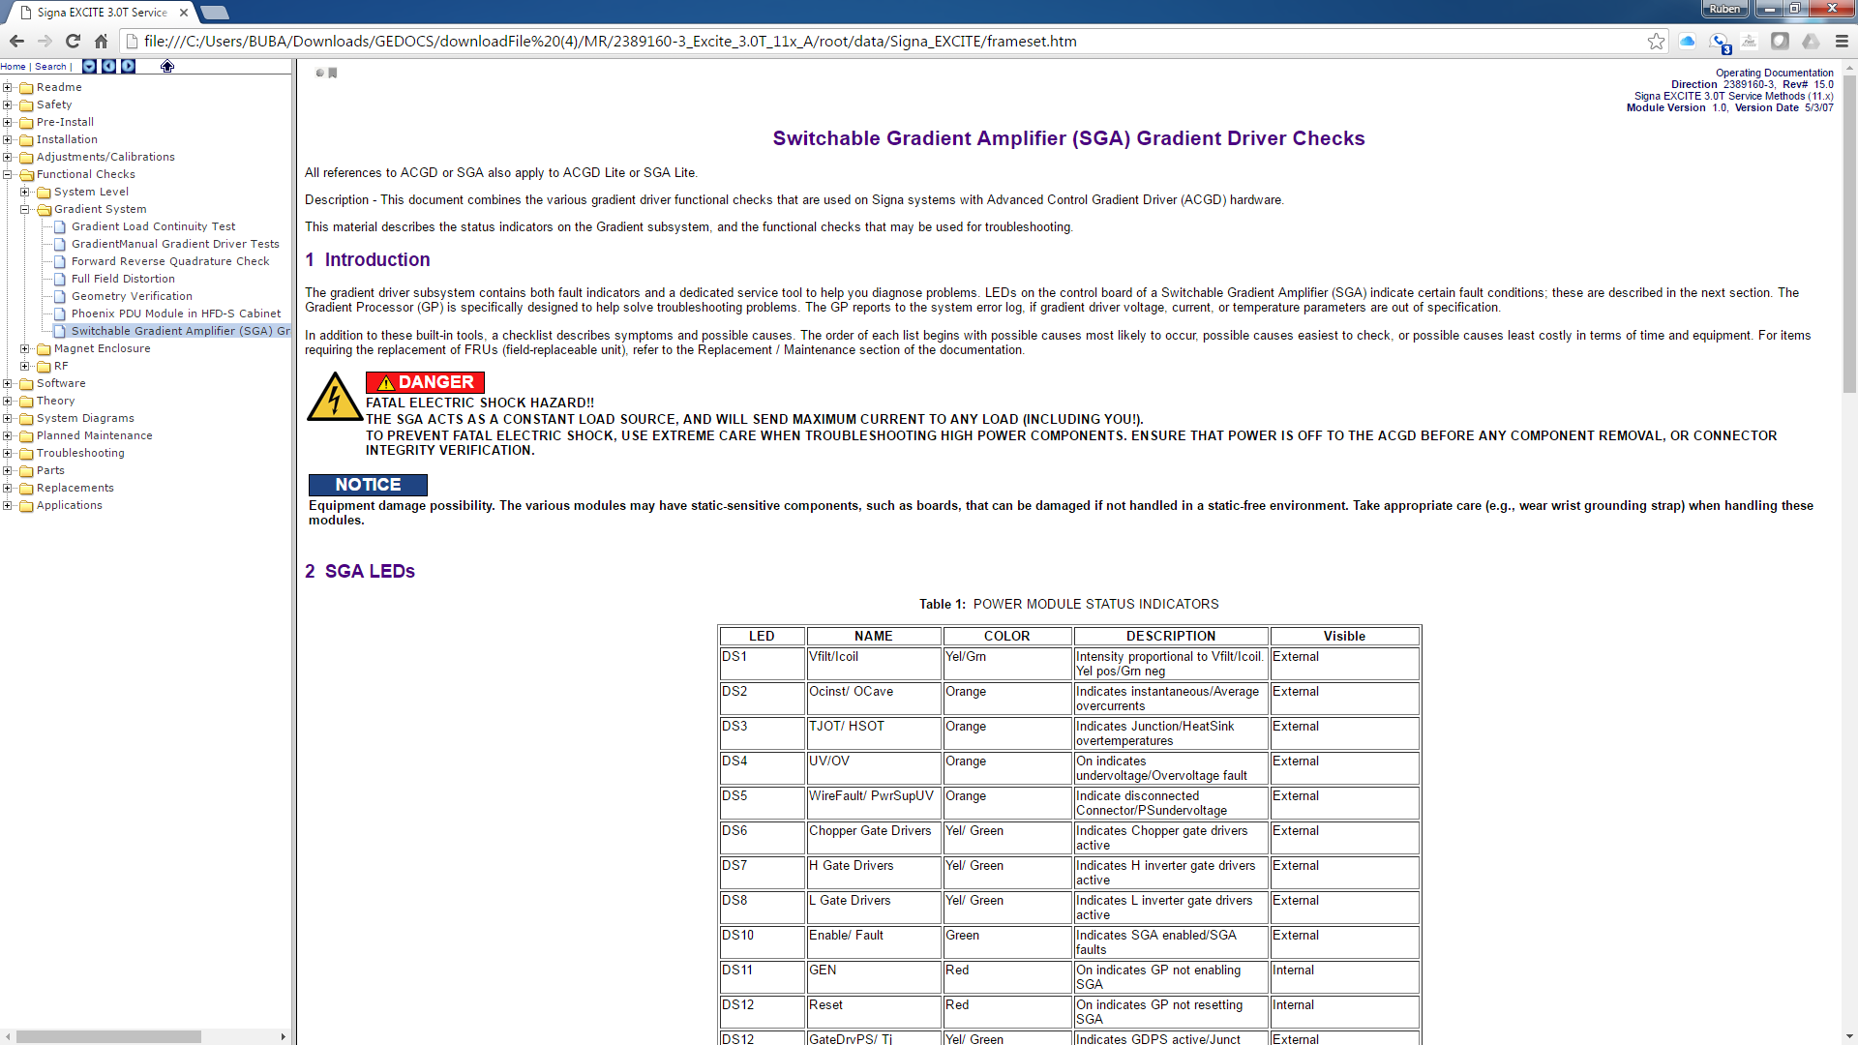
Service Documents
Functional checks has some repeat information from Calibrations but there are some good documents on checks that can be performed.

Slide 27
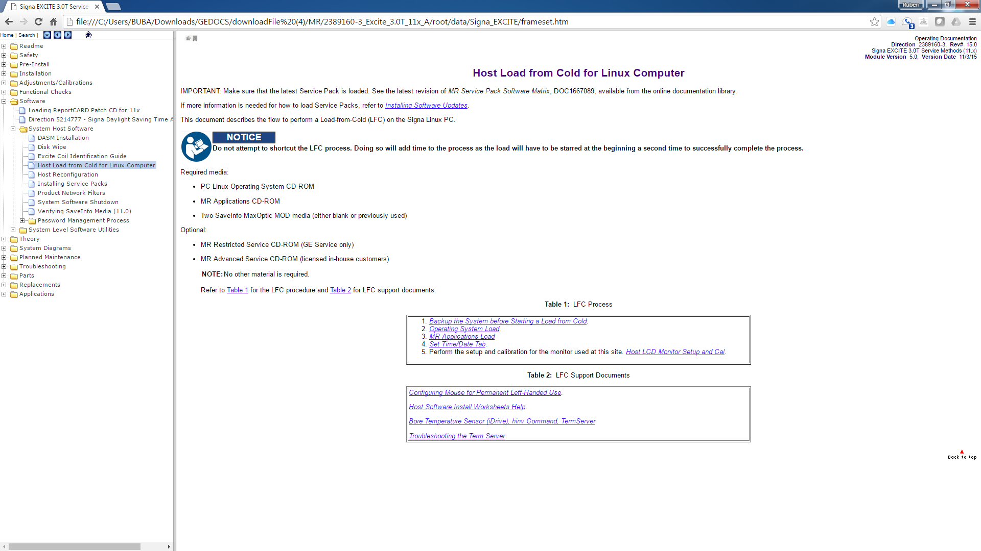
Service Documents
Software tab is everything related to the software in the console. Load from cold it is the most used here to reload the host software.

Slide 28
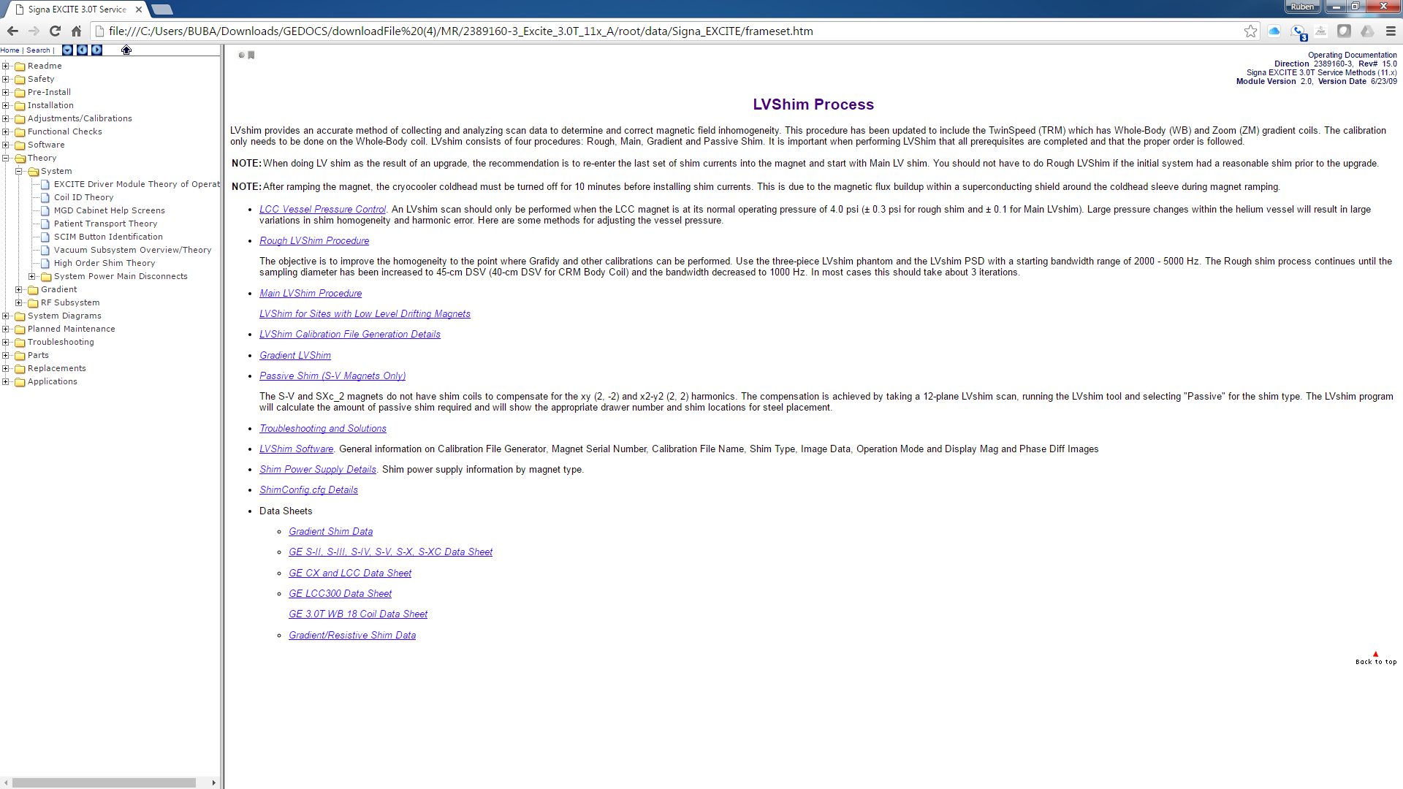
Service Documents
Theory is a great place to read on some of the major components from the MR. Even though GE has been putting less here in the newer systems, you can still find it in older systems on modules that are used in the newer MR platforms.

Slide 29
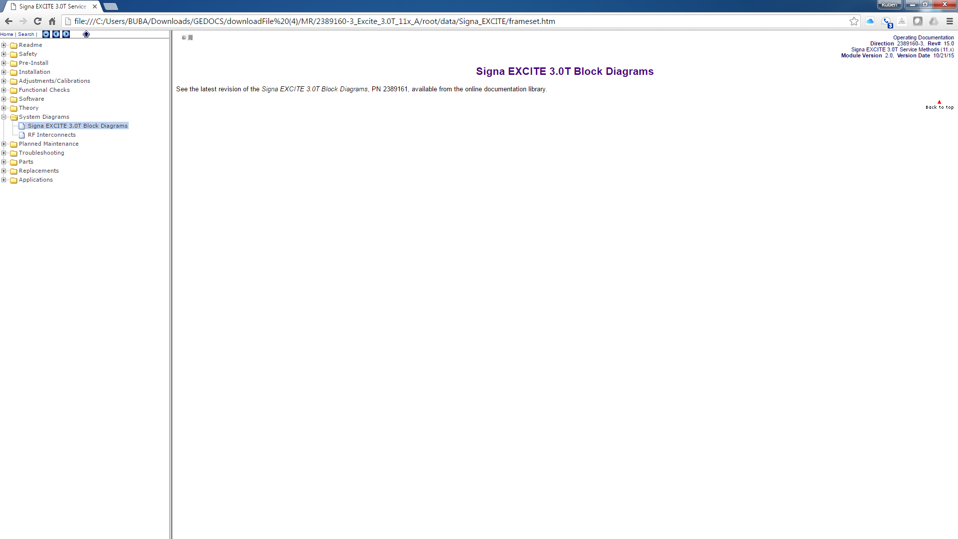
Service Documents
System diagrams have been disappearing out of here too. You can find some good diagrams in the older systems. Some PDFs with diagrams can be found in the CDL website

Slide 30
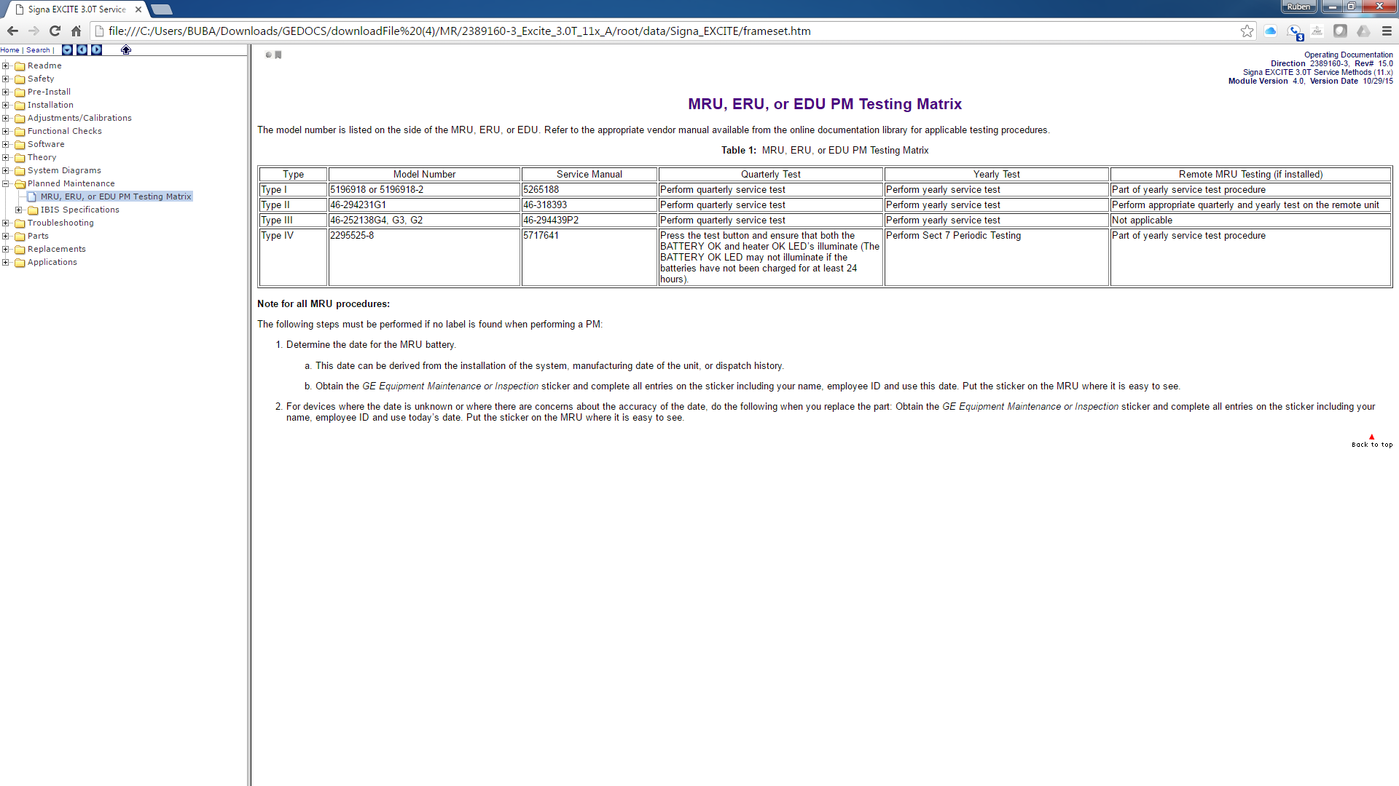
Service Documents
They realized ISO companies could follow GE PM checks so they took that out other than the safety checks if anything.

Slide 31
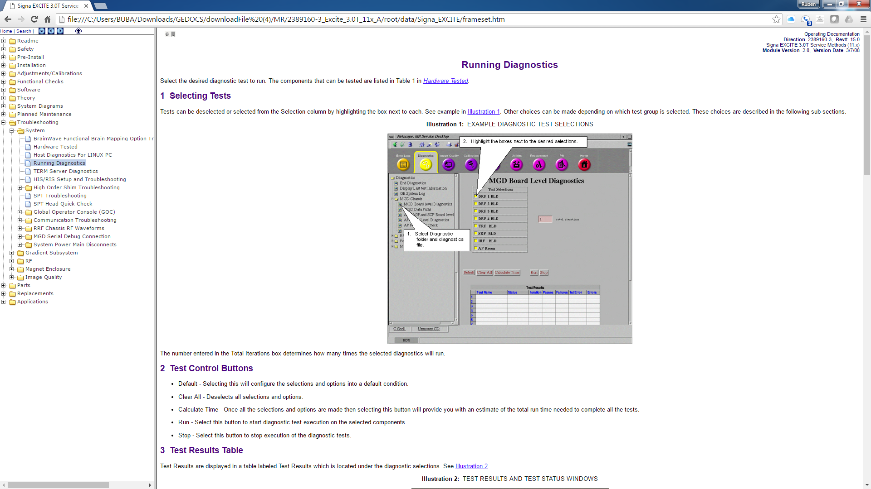
Service Documents
Troubleshooting might be a bit slim too but some good info can be found and some of the diagnostics in the service browser run also without a service key. There are big differences depending in the software level.

Slide 32
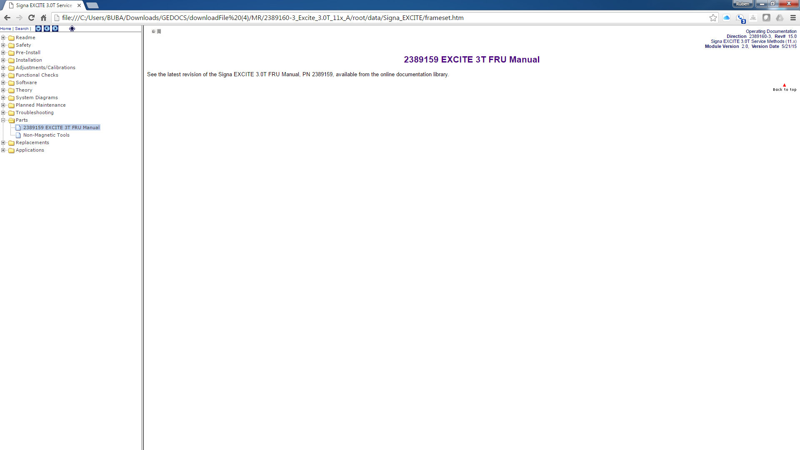
Service Documents
Parts were always here. Now they make you go download the manual. Older revisions had it in this tab. If you have older revisions, don’t delete them. Keep them both because most of the time they just take things away

Slide 33
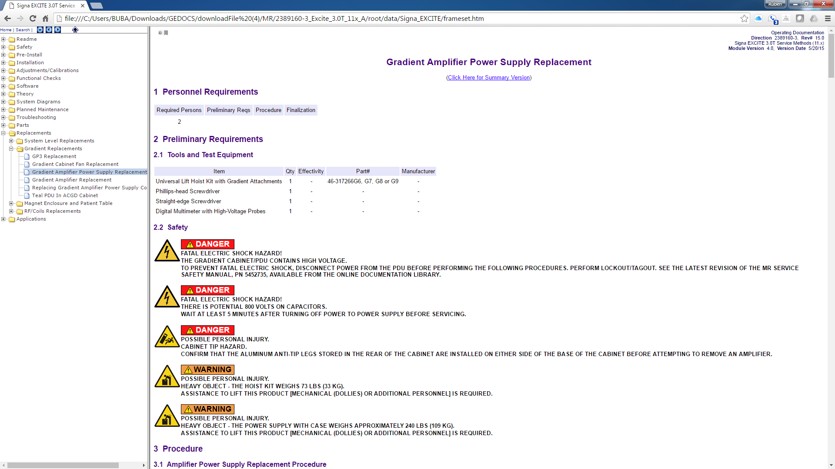
Service Documents
They usually give you quite a bit of replacement information, specially about the parts that have more safety issues involved.

Slide 34
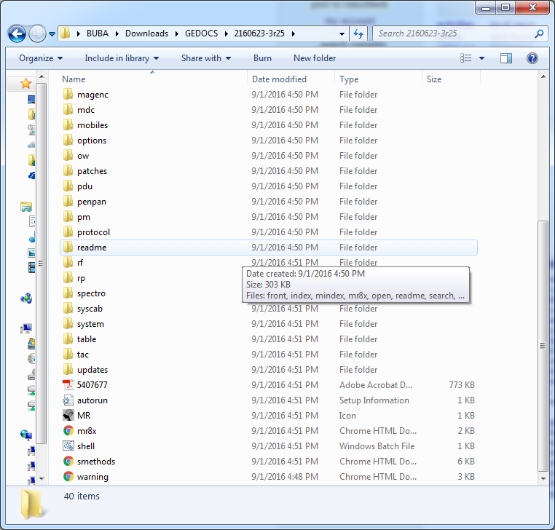
Service Documents
LX Systems have an older different organization of the documents.
The process to download it and unzip it is the same but instead of looking for the index.html to open the main menu we have to locate one that says mr8x.html

Slide 35
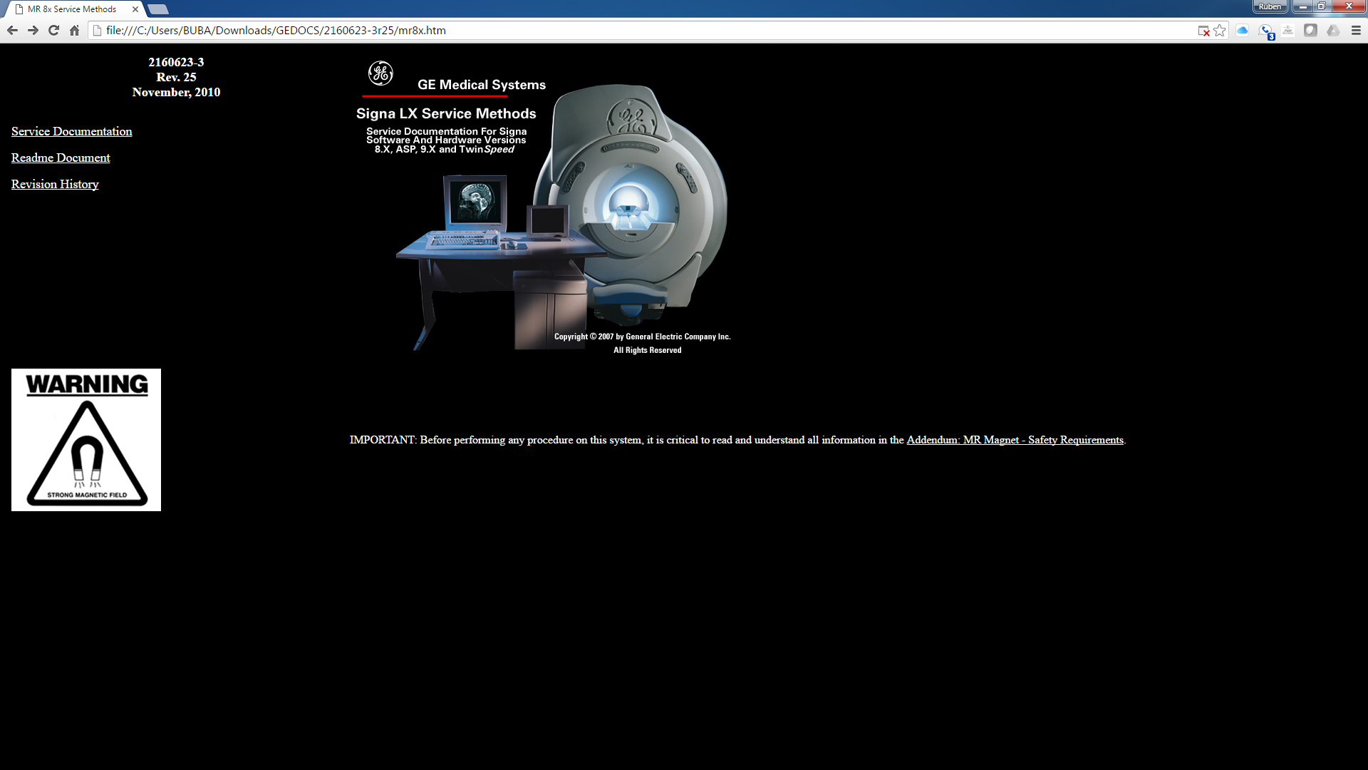
Service Documents

Slide 36
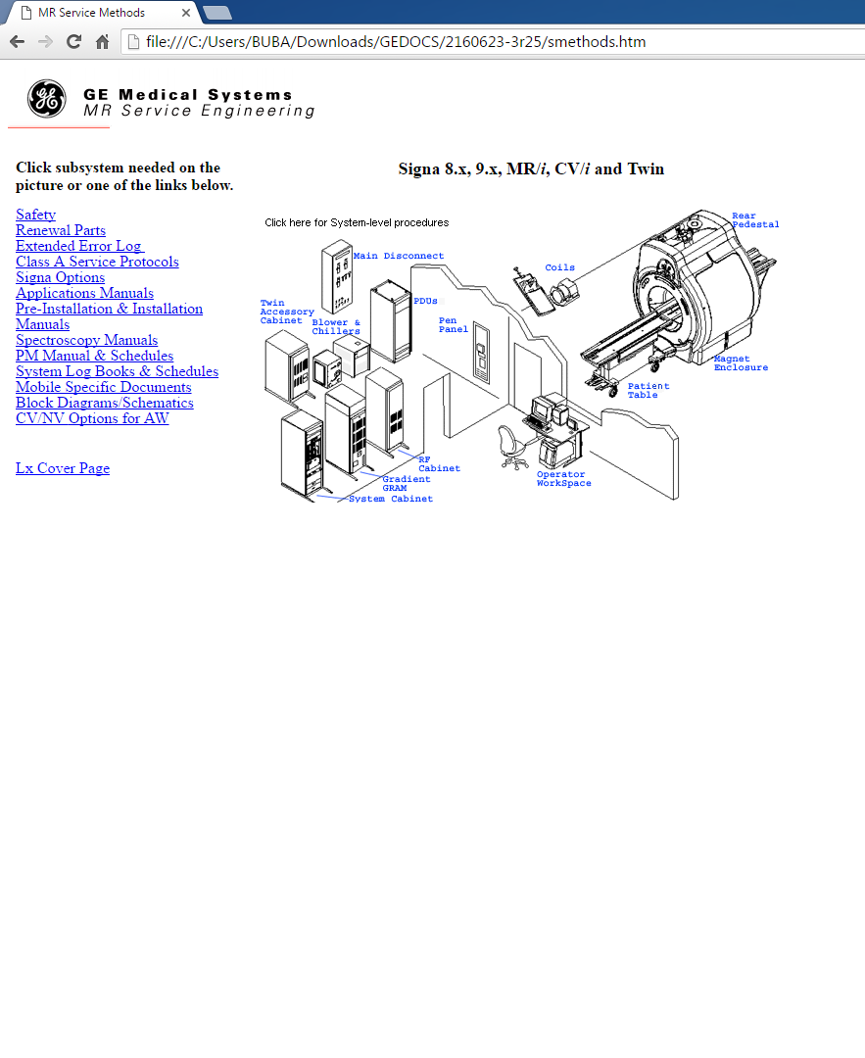
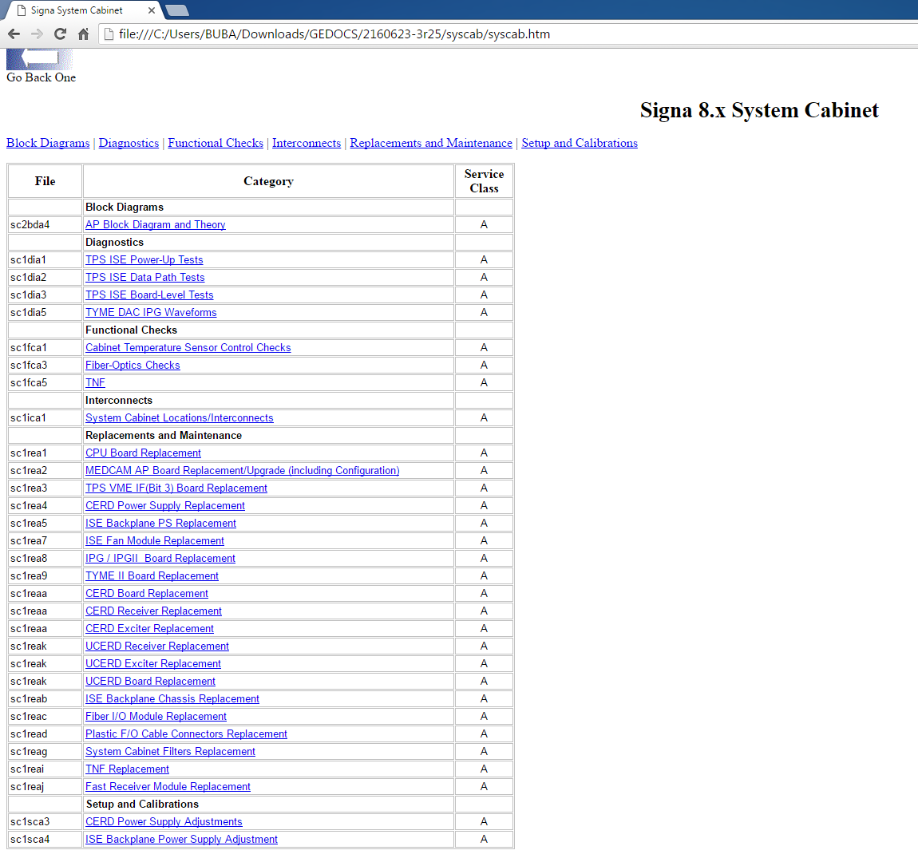
Service Documents
Things are organized a little different but same concept. Under each component you will find the adjustments, checks, troubleshooting and anything related to its components.

Slide 37
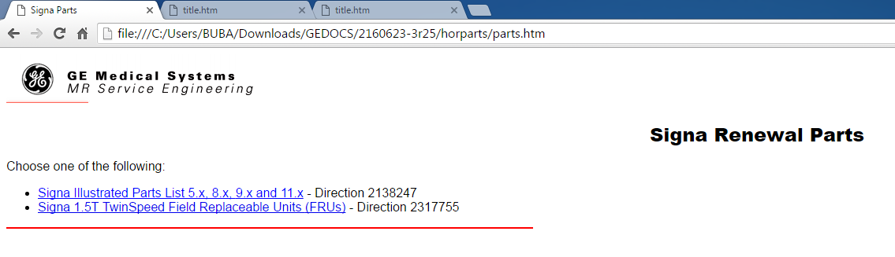
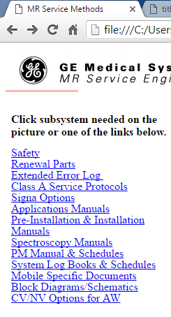
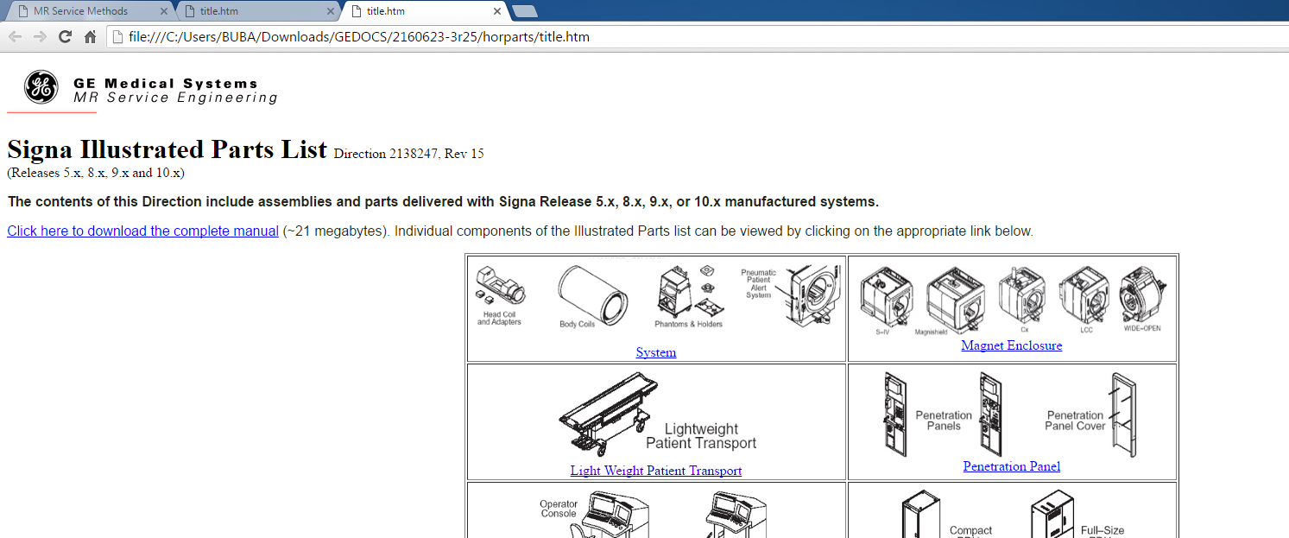
Service Documents
Parts manual can be located under the Renewal parts. It opens another window.
Select the one on the top
You can either download the full pdf manual or locate it by its location in the system

Slide 38
Service Documents To Be Downloaded
Description | Part Number
1.5T Excite (11x) | 2333500-3
GE Signa (8x/9x) | 2160623-3
HD (12x) | 5133315-3
HDx (14x) | 5155501-3
HDxt (15x, 16x, 23x) | 5440001-3
Sofware Matrix | 1667089
Excite Part Manual | 2345481
Excite Block Diagrams | 2333494
HD-HDxt Block Diagrams | 5133310
LCC Magnet | 5495019

Slide 39


